Slide 1
Analyzing Amazon Sales data
Gaurav Kumar Gautam

Slide 2

Objective
Development of a predictive model for predicting sales.
Perform ETL (Extract-Transform-Load) on dataset.
Develop a dashboard by using Tableau.
Python NoteBook:
https://colab.research.google.com/drive/1UvZ-QvcbY-qKw3rmSjiZwH2nGHxBd92k
Tableau Link:
https://public.tableau.com/views/AmazonSalesDataAnalysis_16834047604790/Dashboard1?:language=en-US&:display_count=n&:origin=viz_share_link

Slide 3
What I have learnt from this data
Better understand and optimize revenue generation in future
01
Maximize forecasting accuracy
02
Make current sales experience our top priority
03

Slide 4
Data Preprocessing:
Importing necessary libraries for data analysis such as Pandas, NumPy, Matplotlib & Seaborn, etc.
Using pd.read_csv() function stores the data in pandas data frame named data.
Using data.column showing columns present in the data frame.
info() function shows basic information about the data frame like the null value count of each column and their data type
Changing the data type of different columns for model training and analysis
Using describe function on the data frame for getting basic stats of the numerical dataset
Adding an extra column to the data frame which contains only month, year, and month with year
Using isnull().sum() check out the total null value in all the columns of data frame

Slide 5
Exploratory data Analysis
Checking Outliers in the data frame by using Box Plot
Box Plot for Total Profit: Here we detect outliers in the specified column using the Z-score method and found 7 outliers
Creating a bar chart for Total Revenue and Order Month: where it showcases the number of orders purchased in a particular month.
Calculating the total revenue for each group with respect to Item Type and then sorting them in descending order.
Calculating the total profit for each group with respect to Item Type and then sorting them in descending order
Calculating correlation of the 'Total Revenue', 'Total Cost’, and 'Total Profit' columns present in data frame

Slide 6
Predictive Analytics
Label Encoding of Item Type, Sales Channel, and Order Priority for model training.
Dropping columns Region, Country, Order Date Month Year, Order ID, and Ship Date
Plotting heat map to know correlations between each column
Plotting bar plot to know yearly sales
Plotting line plot to know the total cost of shipping each month
Plotting Piechart to know sales over 3 years

Slide 7
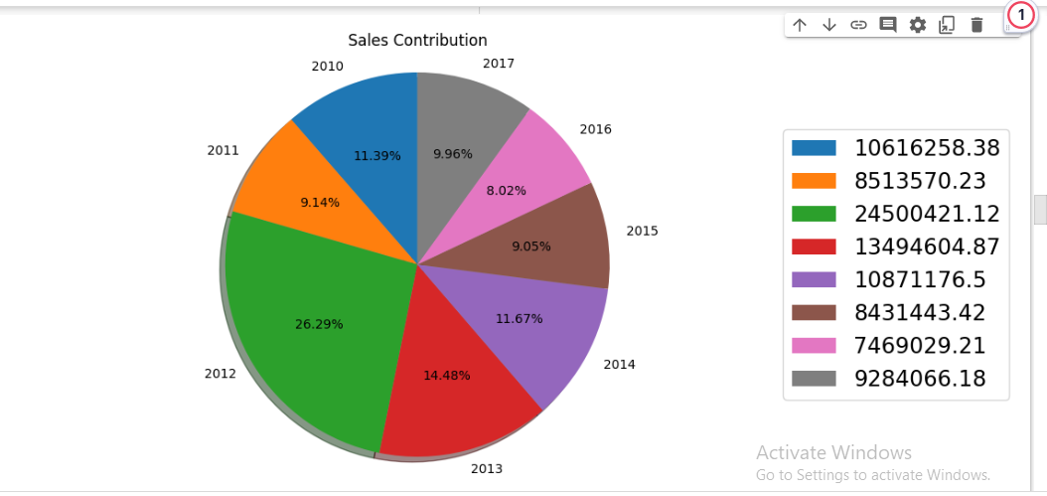
Sales percentage in different years

Slide 8
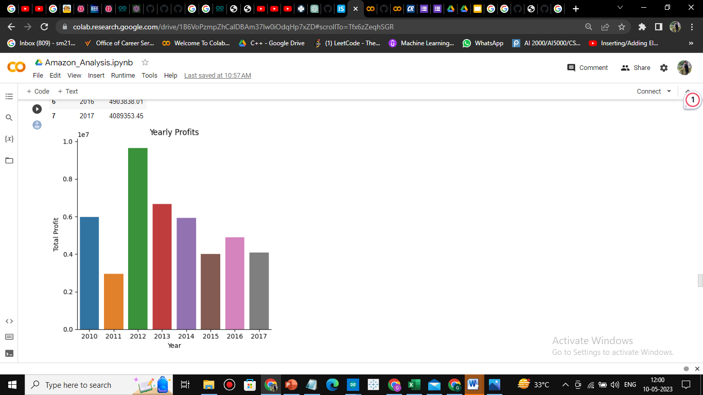
Yearly sales profit

Slide 9
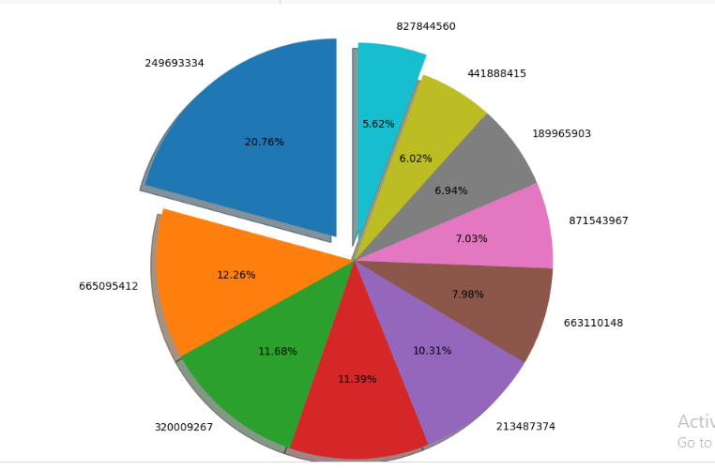
Total Profit on each order ID

